Slide 1

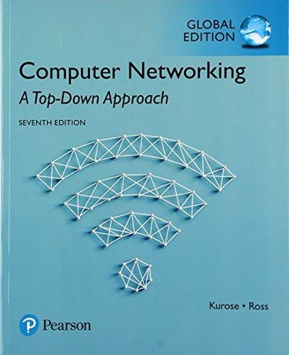
Network Layer I: roadmap
IPv4 & Addressing
IPv4 datagram format
IPv4 addressing
IPv6
Chapter 4.1-4.3

Slide 2
Network Layer II: roadmap
Dynamic Host Configuration Protocol (DHCP)
Network Address Translation (NAT)
Forwarding - what’s inside a router
input ports, switching, output ports
buffer management, scheduling
Chapter 4.1-4.3

Slide 3
Network Layer III: Roadmap
introduction
routing protocols
link state
distance vector
intra-ISP routing: OSPF
routing among ISPs: BGP
Chapter 5.1-5.4

Slide 4

IP fragmentation/reassembly
network links have MTU (max. transmission unit) –the maximum amount of data that a link-layer frame can carry
different link types, different MTUs
large IP datagram divided (“fragmented”) within net
one datagram becomes several datagrams
“reassembled” only at destination
IP header bits used to identify, order related fragments
…
fragmentation:
in: one large datagram
out: 3 smaller datagrams
reassembly
…

Slide 5
Inter-networking: Addressing LANs and Hosts
Hosts within different LANs cannot communicate directly
Disparate LAN technologies (Ethernet, 4G, WiFi, …)
LANs are interconnected through Routers
Routers need to identify each host within a LAN using a single address
Use hierarchical IP addressing scheme – CIDR
IP addresses are divided into two portions
Network portion: The top n bits of the IP address (subnet address)
Host portion: the remaining 32-n bits of the IP address

Slide 6
Subnetting: How IPs are divided with Net Masks
Masks are 32-bit number (like IP addresses)
Must be a contiguous prefix of 1s, then 0s thereafter
The 1s determine the network part, the 0s the host part
The number of 1s determines the mask length
Example:
What is the subnet address for the following IP and mask combination?
IP address: 10.0.8.23
IP mask: 255.255.254.0
What is the range of potential host addresses?

Slide 7
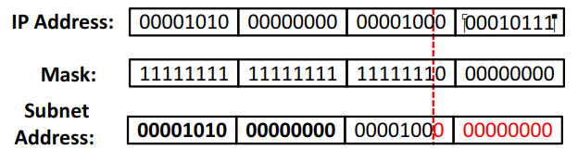

Subnetting: How IPs are divided with Net Masks
Logical AND between IP and Mask
Subnet address: 10.0.8.0/23
Range of host addresses:
10.0.8.0 to 10.0.9.255
00001010 . 00000000 . 0000100 0 . 00000000
00001010 . 00000000 . 0000100 1 . 11111111

Slide 8
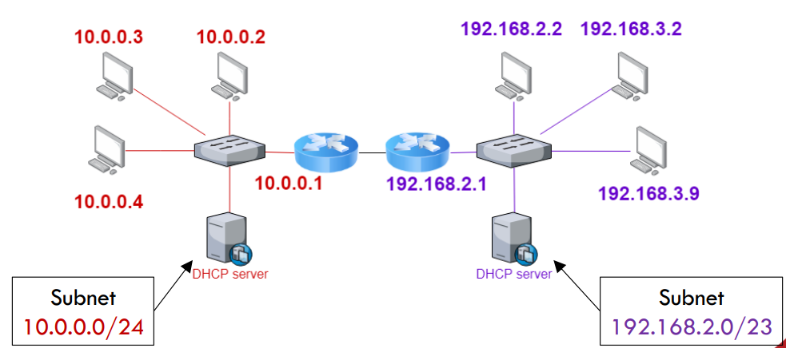
Addressing: Allocating IP addresses to LAN hosts
A DHCP server allocates IP addresses to network devices connected in the same LAN
DHCP server should be configured with subnet IP and mask

Slide 9
NAT: network address translation
Local network uses just one IP address as far as outside world is concerned
advantages:
just one IP address needed from provider ISP for all devices
can change addresses of devices in local network without notifying outside world
can change ISP without changing addresses of devices in local network
security: devices inside local net not directly addressable, visible by outside world

Slide 10
NAT: network address translation
implementation: NAT router must (transparently):
outgoing datagrams: replace (source IP address, port #) of every outgoing datagram to (NAT IP address, new port #)
remote clients/servers will respond using (NAT IP address, new port #) as destination address
remember (in NAT translation table) every (source IP address, port #) to (NAT IP address, new port #) translation pair
incoming datagrams: replace (NAT IP address, new port #) in destination fields of every incoming datagram with corresponding (source IP address, port #) stored in NAT table

Slide 11

NAT: network address translation
NAT translation table
WAN side addr LAN side addr
2: NAT router changes datagram source address from 10.0.0.1, 3345 to 138.76.29.7, 5001,
updates table
1: host 10.0.0.1 sends datagram to 128.119.40.186, 80
138.76.29.7, 5001 10.0.0.1, 3345
…… ……
S: 10.0.0.1, 3345
D: 128.119.40.186, 80
10.0.0.1
1
2
S: 138.76.29.7, 5001
D: 128.119.40.186, 80
10.0.0.4
10.0.0.2
138.76.29.7
S: 128.119.40.186, 80
D: 10.0.0.1, 3345
4
S: 128.119.40.186, 80
D: 138.76.29.7, 5001
3
10.0.0.3
3: reply arrives, destination address: 138.76.29.7, 5001

Slide 12
Network-layer functions
forwarding: move packets from router’s input to appropriate router output
data plane
routing: determine route taken by packets from source to destination
control plane
Two approaches to structuring network control plane:
per-router control (traditional)
logically centralized control (software defined networking)

Slide 13


















Routing protocols
mobile network
Routing protocol goal: determine “good” paths (equivalently, routes), from sending hosts to receiving host, through network of routers
path: sequence of routers packets traverse from given initial source host to final destination host
“good”: least “cost”, “fastest”, “least congested”
routing: a “top-10” networking challenge!
national or global ISP
application
transport
network
link
physical
network
link
physical
network
link
physical
network
link
physical
network
link
physical
network
link
physical
datacenter
network
application
transport
network
link
physical
enterprise
network

Slide 14

Dijkstra’s link-state routing algorithm
centralized: network topology, link costs known to all nodes
accomplished via “link state broadcast”
all nodes have same info
computes least cost paths from one node (“source”) to all other nodes
gives forwarding table for that node
iterative: after k iterations, know least cost path to k destinations
notation
u: source node
c_{x,y}: direct link cost from node x to y; = ∞ if not direct neighbors
D(v): current estimate of cost of least-cost-path from source to destination v
p(v): predecessor node along path from source to v
N': set of nodes whose least-cost-path definitively known

Slide 15
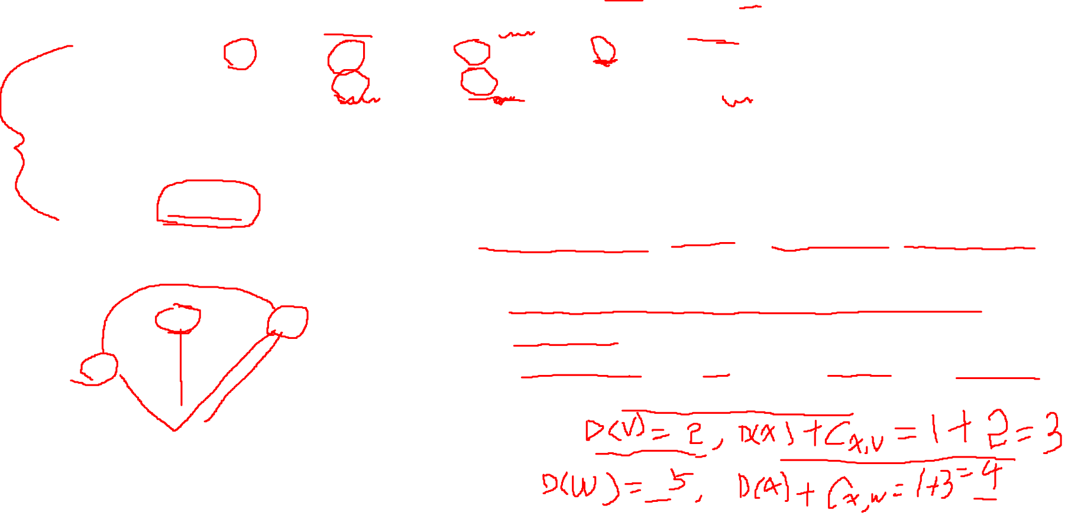
Dijkstra’s algorithm: an example
v
w
x
y
z
Step
0
1
2
3
4
5
N'
D(v),p(v)
D(w),p(w)
D(x),p(x)
D(y),p(y)
D(z),p(z)
u
2,u
5,u
1,u
∞
∞
ux
2,u
4,x
2,x
∞
uxy
2,u
3,y
4,y
uxyv
3,y
4,y
uxyvw
4,y
uxyvwz
Initialization (step 0): For all a: if a adjacent to then D(a) = c_{u,a}
5
find a not in N' such that D(a) is a minimum
add a to N'
update D(b) for all b adjacent to a and not in N' :
D(b) = min ( D(b), D(a) + c_{a,b} )
v
3
w
2
5
u
2
1
z
3
1
2
x
y
1

Slide 16
Distance vector algorithm
key idea:
from time-to-time, each node sends its own distance vector estimate to neighbors
when x receives new DV estimate from any neighbor, it updates its own DV using B-F equation:
D_{x}(y) ← min_{v}{c_{x,v} + D_{v}(y)} for each node y ∊ N
under minor, natural conditions, the estimate D_{x}(y) converge to the actual least cost d_{x}(y)

Slide 17
Distance vector algorithm:
each node:
iterative, asynchronous: each local iteration caused by:
local link cost change
DV update message from neighbor
wait for (change in local link cost or msg from neighbor)
recompute DV estimates using DV received from neighbor
distributed, self-stopping: each node notifies neighbors only when its DV changes
neighbors then notify their neighbors – only if necessary
no notification received, no actions taken!
if DV to any destination has changed, notify neighbors

Slide 18
Distance vector example: computation
DV in b:
DV in c:
D_{c}(a) = ∞
D_{c}(b) = 1
D_{c}(c) = 0
D_{c}(d) = ∞
D_{c}(e) = ∞
D_{c}(f) = ∞
D_{c}(g) = ∞
D_{c}(h) = ∞
D_{c}(i) = ∞
D_{b}(a) = 8
D_{b}(c) = 1
D_{b}(d) = ∞
D_{b}(e) = 1
D_{b}(f) = ∞
D_{b}(g) = ∞
D_{b}(h) = ∞
D_{b}(i) = ∞
DV in a: D_{a}(a)=0
D_{a}(b) = 8
D_{a}(c) = ∞
D_{a}(d) = 1
D_{a}(e) = ∞
D_{a}(f) = ∞
D_{a}(g) = ∞
D_{a}(h) = ∞
D_{a}(i) = ∞
a
b
c
8
1
t=1
1
1
b receives DVs from a, c, e
DV in e:
D_{e}(a) = ∞
D_{e}(b) = 1
D_{e}(c) = ∞
D_{e}(d) = 1
D_{e}(e) = 0
D_{e}(f) = 1
D_{e}(g) = ∞
D_{e}(h) = 1
D_{e}(i) = ∞
d
e
f
1
1
1
1
1
g
h
i
1
1

Slide 19
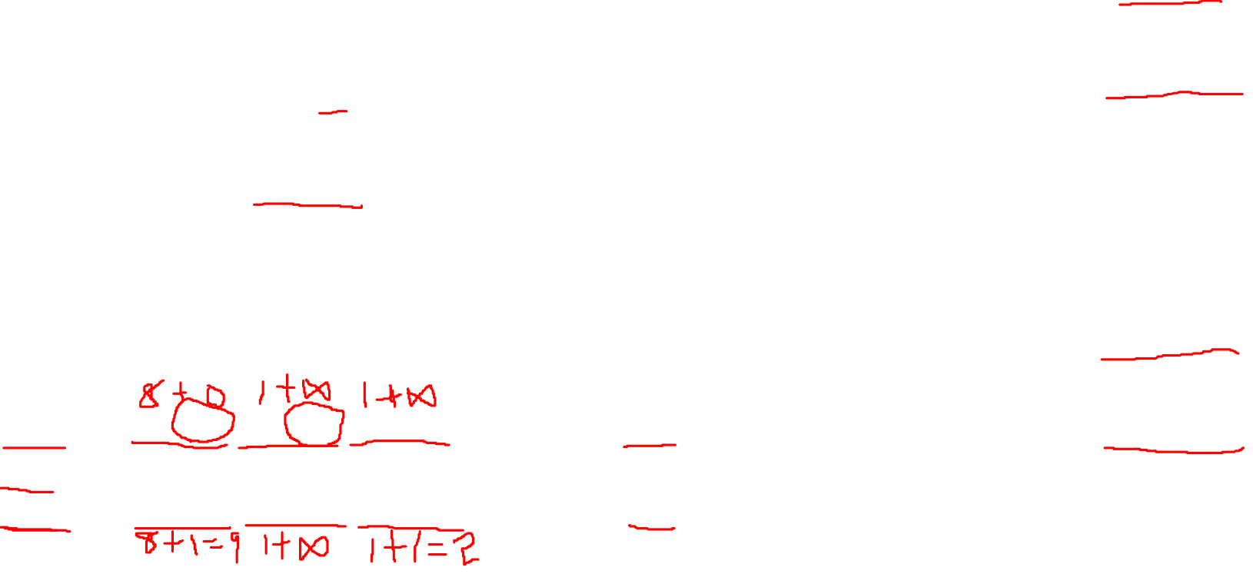
Distance vector example: computation
DV in b:
DV in c:
D_{c}(a) = ∞
D_{c}(b) = 1
D_{c}(c) = 0
D_{c}(d) = ∞
D_{c}(e) = ∞
D_{c}(f) = ∞
D_{c}(g) = ∞
D_{c}(h) = ∞
D_{c}(i) = ∞
D_{b}(a) = 8
D_{b}(c) = 1
D_{b}(d) = ∞
D_{b}(e) = 1
D_{b}(f) = ∞
D_{b}(g) = ∞
D_{b}(h) = ∞
D_{b}(i) = ∞
DV in a: D_{a}(a)=0
D_{a}(b) = 8
D_{a}(c) = ∞
D_{a}(d) = 1
D_{a}(e) = ∞
D_{a}(f) = ∞
D_{a}(g) = ∞
D_{a}(h) = ∞
D_{a}(i) = ∞
a
b
c
b
8
compute
1
t=1
1
1
b receives DVs from a, c, e, computes:
DV in e:
D_{e}(a) = ∞
D_{e}(b) = 1
D_{e}(c) = ∞
D_{e}(d) = 1
D_{e}(e) = 0
D_{e}(f) = 1
D_{e}(g) = ∞
D_{e}(h) = 1
D_{e}(i) = ∞
e
d
e
f
1
1
D_{b}(a) = min{c_{b,a}+D_{a}(a), c_{b,c} +D_{c}(a), c_{b,e}+D_{e}(a)} = min{8,∞,∞} = 8
D_{b}(c) = min{c_{b,a}+D_{a}(c), c_{b,c} +D_{c}(c), c _{b,e} +D_{e}(c)} = min{∞,1,∞} = 1
D_{b}(d) = min{c_{b,a}+D_{a}(d), c_{b,c} +D_{c}(d), c _{b,e} +D_{e}(d)} = min{9,2,∞} = 2
1
1
1
D_{b}(e) = min{c_{b,a}+D_{a}(e), c_{b,c} +D_{c}(e), c _{b,e} +D_{e}(e)} = min{∞,∞,1} = 1
DV in b:
D_{b}(f) = min{c_{b,a}+D_{a}(f), c_{b,c} +D_{c}(f), c _{b,e} +D_{e}(f)} = min{∞,∞,2} = 2
D_{b}(g) = min{c_{b,a}+D_{a}(g), c_{b,c} +D_{c}(g), c _{b,e}+D_{e}(g)} = min{∞, ∞, ∞} = ∞
D_{b}(a) = 8
D_{b}(c) = 1
D_{b}(d) = 2
D_{b}(e) = 1
D_{b}(f) =2
D_{b}(g) = ∞
D_{b}(h) = 2
D_{b}(i) = ∞
g
h
1
i
1
D_{b}(h) = min{c_{b,a}+D_{a}(h), c_{b,c} +D_{c}(h), c _{b,e}+D_{e}(h)} = min{∞, ∞, 2} = 2
D_{b}(i) = min{c_{b,a}+D_{a}(i), c_{b,c} +D_{c}(i), c _{b,e}+D_{e}(i)} = min{∞, ∞, ∞} = ∞

Slide 20
Intra-AS routing: OSPF (Open Shortest Path First)
“open”: publicly available
one intra-AS routing protocol
classic link-state
each router floods OSPF link-state advertisements (directly over IP rather than using TCP/UDP) to all other routers in entire AS
multiple link cost metrics possible: bandwidth, delay
each router has full topology, uses Dijkstra’s algorithm to compute forwarding table
security: all OSPF messages authenticated (to prevent malicious intrusion)

Slide 21
Internet inter-AS routing: BGP
BGP (Border Gateway Protocol): the de facto inter-domain routing protocol
“glue that holds the Internet together”
Decentralized, based on distance vector algorithm
allows subnet to advertise its existence, and the destinations it can reach, to rest of Internet: “I exist and I am here”
BGP provides each AS a means to:
eBGP: obtain subnet reachability information from neighboring ASes
iBGP: propagate reachability information to all AS-internal routers.
determine “good” routes to other networks based on reachability information and policy

